Slide 1

Algebra 1
Unit 1, Lesson 5 Exploring Rational Exponents Volume 1, pg. 27

Slide 2


Benchmark
MA.912.NSO.1.1
Extend previous understanding of the Laws of Exponents to include rational exponents. Apply the Laws of Exponents to evaluate numerical expressions and generate equivalent numerical expressions involving rational exponents.
volume 1, pg. 27

Slide 3
Integrated Mathematical Thinking and Reasoning Standards
MA.K12.MTR.2.1 Demonstrate understanding by representing problems in multiple ways.
MA.K12.MTR.4.1 Engage in discussions that reflect on the mathematical thinking of self and others.
MA.K12.MTR.5.1 Use patterns and structure to help understand and connect mathematical concepts.
MA.K12.MTR.6.1 Assess the reasonableness of solutions.
volume 1, pg. 27

Slide 4

Learning Targets
I can apply the Laws of Exponents to rational exponents.
I can convert between expressions involving rational exponents and expressions involving radicals.
volume 1, pg. 27

Slide 5

Warm-Up
volume 1, pg. 27

Slide 6
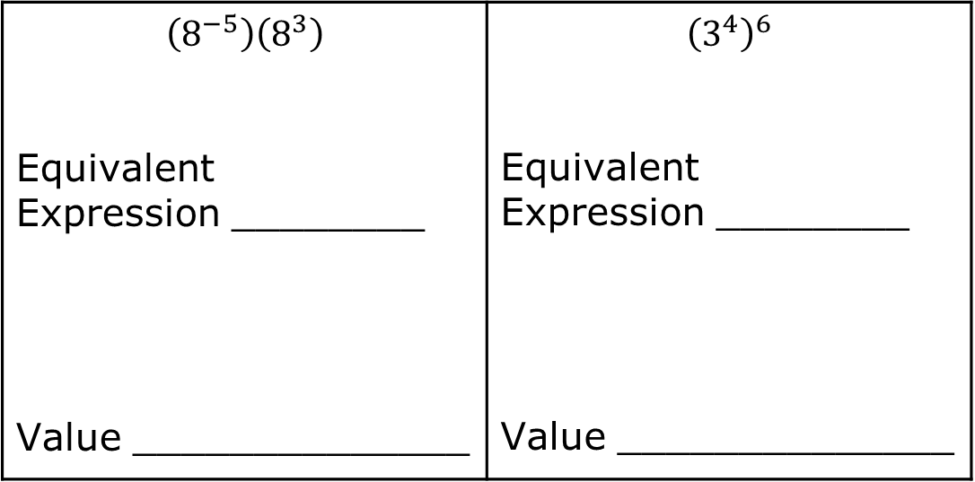
1.5.1 Warm-Up: Bell Work
Use the Laws of Exponents to write an equivalent expression. Then, find the value of each expression. If necessary, use a calculator to find the value of the equivalent expression.
$$\left(8^{−5}\right)\left(8^{3}\right)$$ Equivalent Expression ________ Value ______________ | $${\left(3^{4}\right)}^{6}$$ Equivalent Expression ________ Value ______________
volume 1, pg. 27
Notes:
Video Link: https://algebranation.wistia.com/medias/fi4fidi5y8

Slide 7
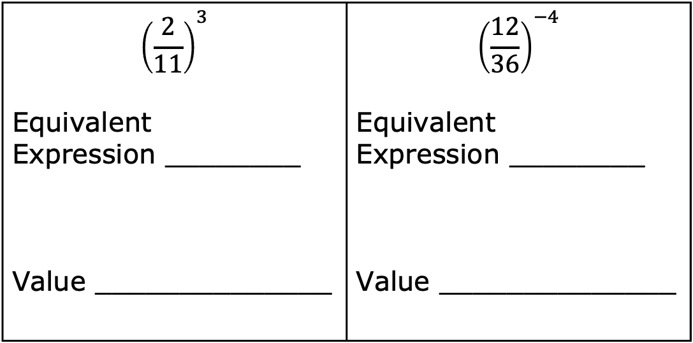
$${\left(\frac{2}{11}\right)}^{3}$$ Equivalent Expression ________ Value ______________ | $${\left(\frac{12}{36}\right)}^{−4}$$ Equivalent Expression ________ Value ______________
volume 1, pg. 27

Slide 8

Exploration
volume 1, pg. 28

Slide 9

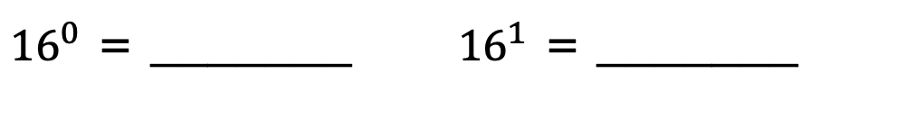
1.5.2 Exploration: Rational Exponents
Fill in the blank with the value of each.
${16}^{0}$ = _______ | ${16}^{1}$ = _______
Using the values above, guess the value of ${16}^{\frac{1}{2}}$.
volume 1, pg. 28

Slide 10
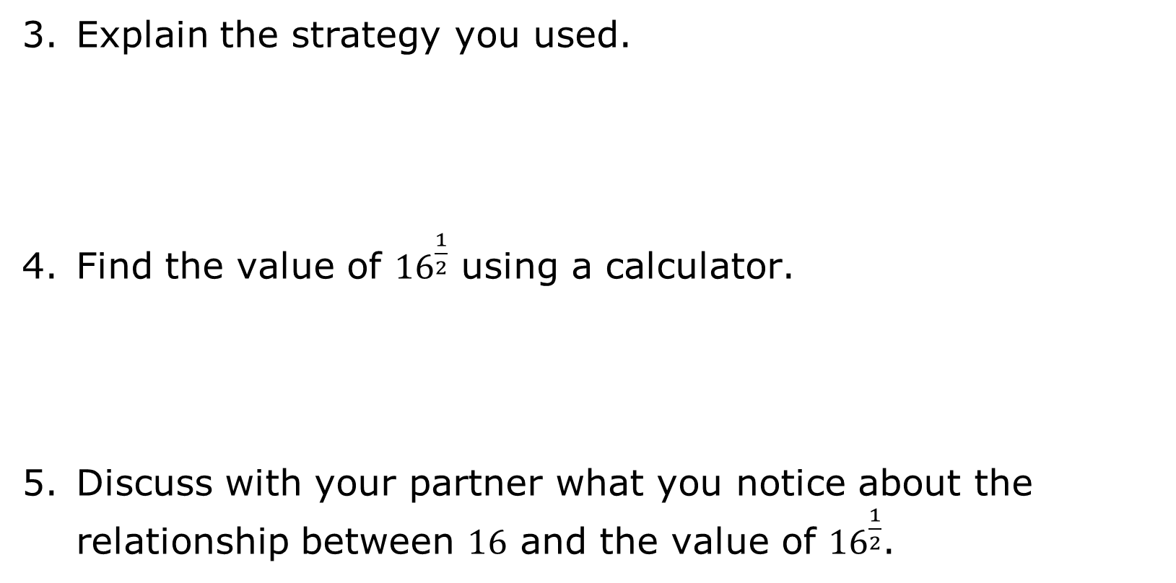
Explain the strategy you used.
Find the value of ${16}^{\frac{1}{2}}$ using a calculator.
Discuss with your partner what you notice about the relationship between $16$ and the value of ${16}^{\frac{1}{2}}$.
volume 1, pg. 28

Slide 11
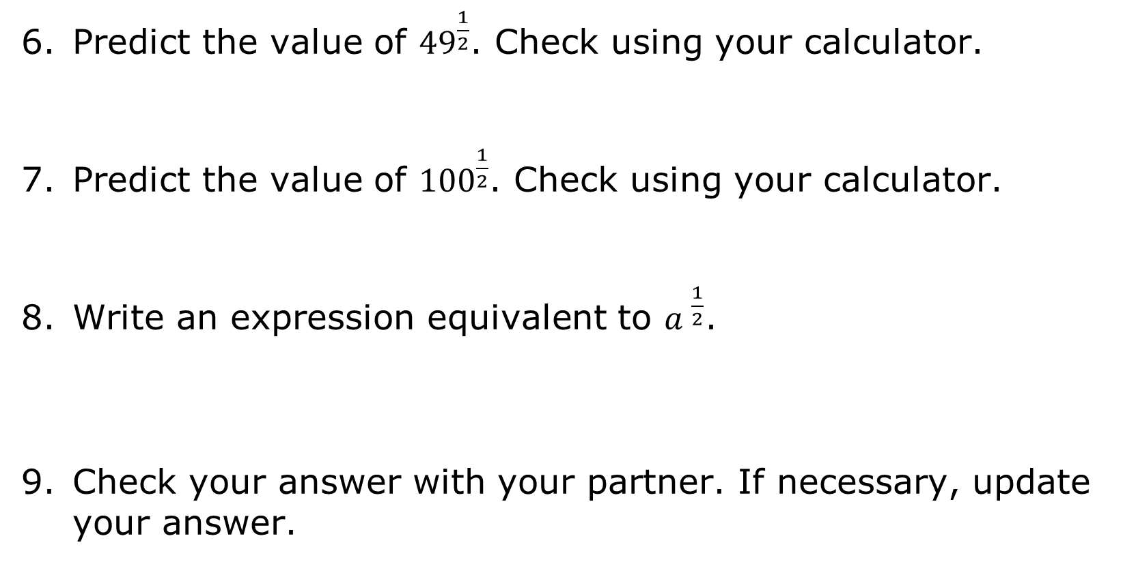
Predict the value of ${49}^{\frac{1}{2}}$. Check using your calculator.
Predict the value of ${100}^{\frac{1}{2}}$. Check using your calculator.
Write an expression equivalent to ${a }^{\frac{1}{2}}$.
Check your answer with your partner. If necessary, update your answer.
volume 1, pg. 28

Slide 12
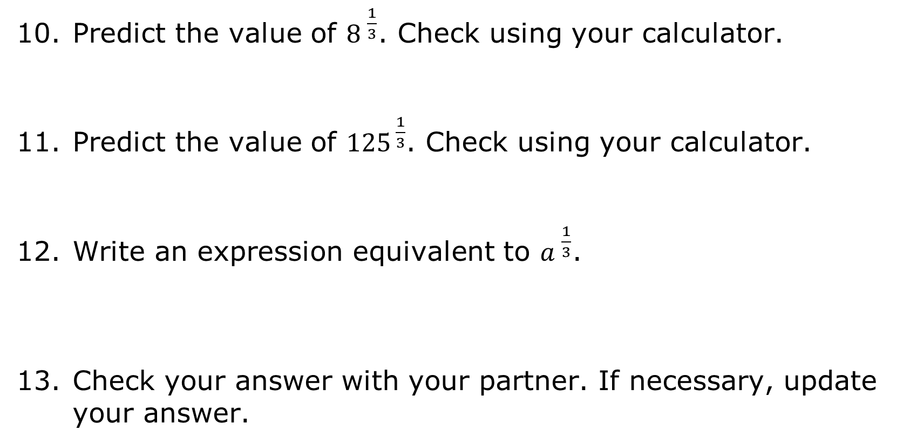
Predict the value of ${8 }^{\frac{1}{3}}$. Check using your calculator.
Predict the value of ${125}^{ \frac{1}{3}}$. Check using your calculator.
Write an expression equivalent to ${a }^{\frac{1}{3}}$.
Check your answer with your partner. If necessary, update your answer.
volume 1, pg. 28

Slide 13

Guided Instruction
volume 1, pg. 29

Slide 14

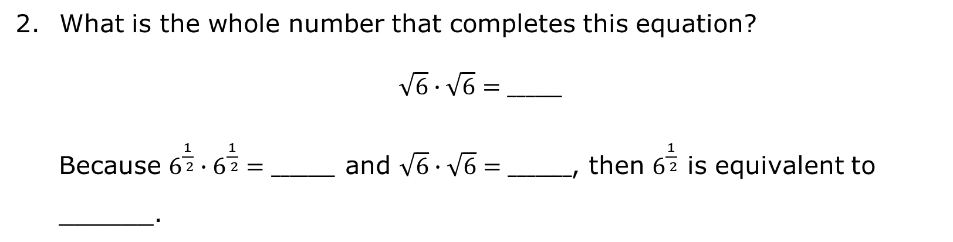
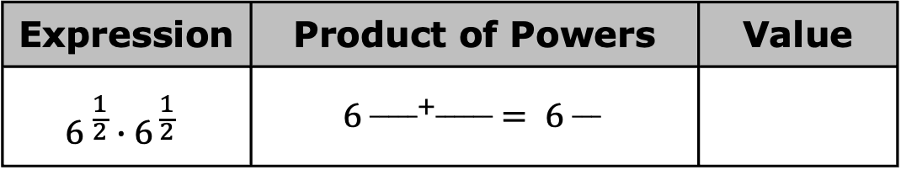
1.5.3 Guided Instruction: Why Does That Work?
Use the product of powers law, $a^{m}∙a^{n}=a^{m+n}$, to evaluate the expression.
Expression | Product of Powers | Value
$${6 }^{\frac{1}{2}}∙6^{ \frac{1}{2}}$$ | $${ 6 }^{_____+______} = {6 }^{___}$$
What is the whole number that completes this equation?
$$\sqrt{6}∙\sqrt{6}=______$$
Because $6^{\frac{1}{ 2}}∙6^{\frac{1}{ 2}}=_______$and $\sqrt{6}∙\sqrt{6}=_______$, then $6^{\frac{1}{ 2}}$ is equivalent to ______.
volume 1, pg. 29

Slide 15
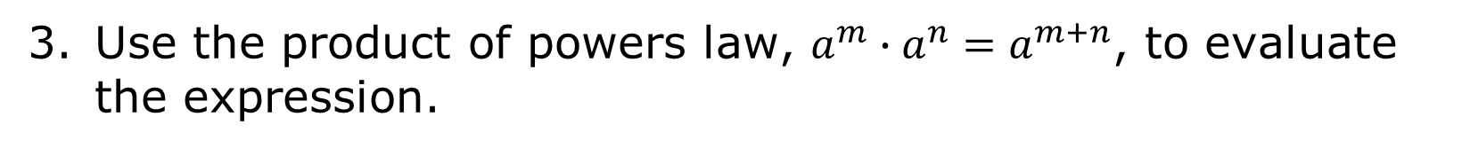
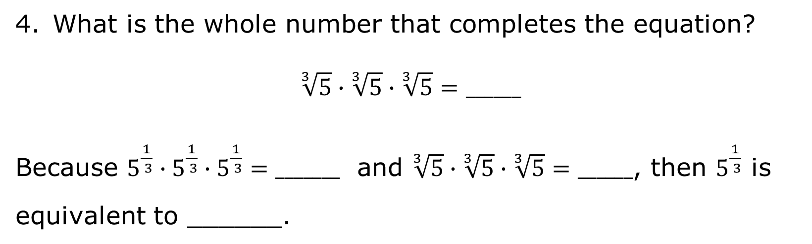
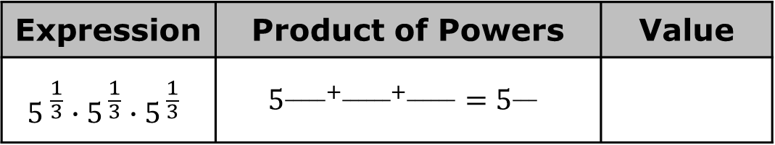
Use the product of powers law, $a^{m}∙a^{n}=a^{m+n}$, to evaluate the expression.
Expression | Product of Powers | Value
$${5 }^{\frac{1}{3}}∙5^{ \frac{1}{3}}∙5^{ \frac{1}{3}}$$ | $$5^{_____+______+______}=5^{___}$$
What is the whole number that completes the equation?
$$\sqrt[3]{5}∙\sqrt[3]{5}∙\sqrt[3]{5}=______$$
Because $5^{\frac{1}{ 3}}∙5^{\frac{1}{ 3}}∙5^{\frac{1}{ 3}}=_______$ and $\sqrt[3]{5}∙\sqrt[3]{5}∙\sqrt[3]{5}=______$, then $5^{\frac{1}{ 3}}$ is equivalent to ______.
volume 1, pg. 29

Slide 16
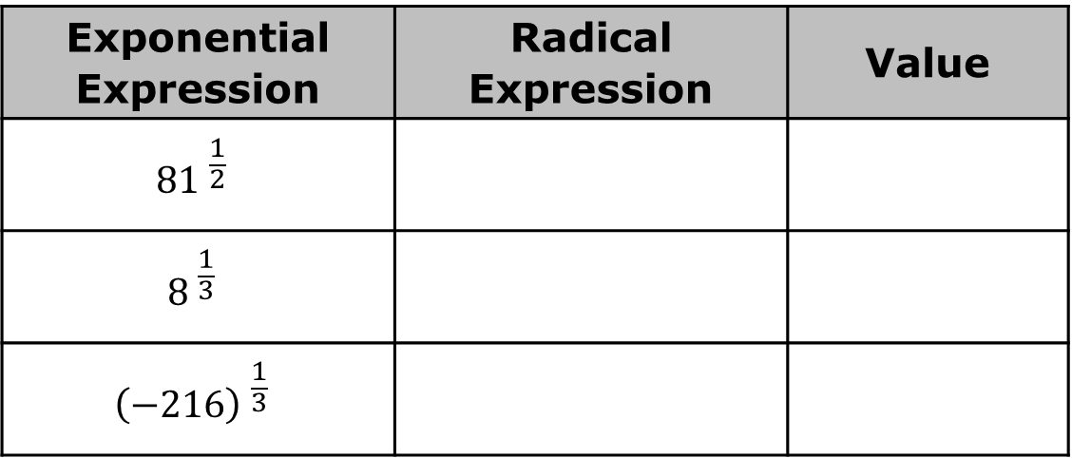
Rewrite each exponential expression as a radical expression. Then, evaluate each expression.
Exponential Expression | Radical Expression | Value
$${81 }^{\frac{1}{2}}$$
$${8 }^{\frac{1}{3}}$$
$${\left(−216\right) }^{\frac{1}{3}}$$
volume 1, pg. 29

Slide 17
Exploration
volume 1, pg. 30

Slide 18
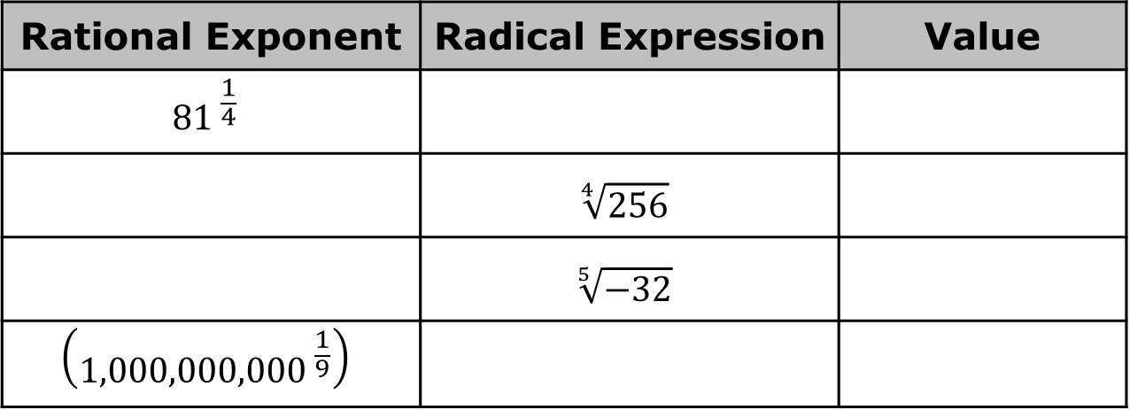
1.5.4 Exploration: Other Roots
Rewriting exponential expressions as radical expressions does not only apply to square roots and cube roots. Other roots apply these same principals.
Complete the table to explore other rational exponents and roots.
Rational Exponent | Radical Expression | Value
$${81 }^{\frac{1}{4}}$$
 | $$\sqrt[4]{256}$$
 | $$\sqrt[5]{−32}$$
$$\left({1,000,000,000 }^{\frac{1}{9}}\right)$$
volume 1, pg. 30

Slide 19
Guided Instruction
volume 1, pg. 30

Slide 20
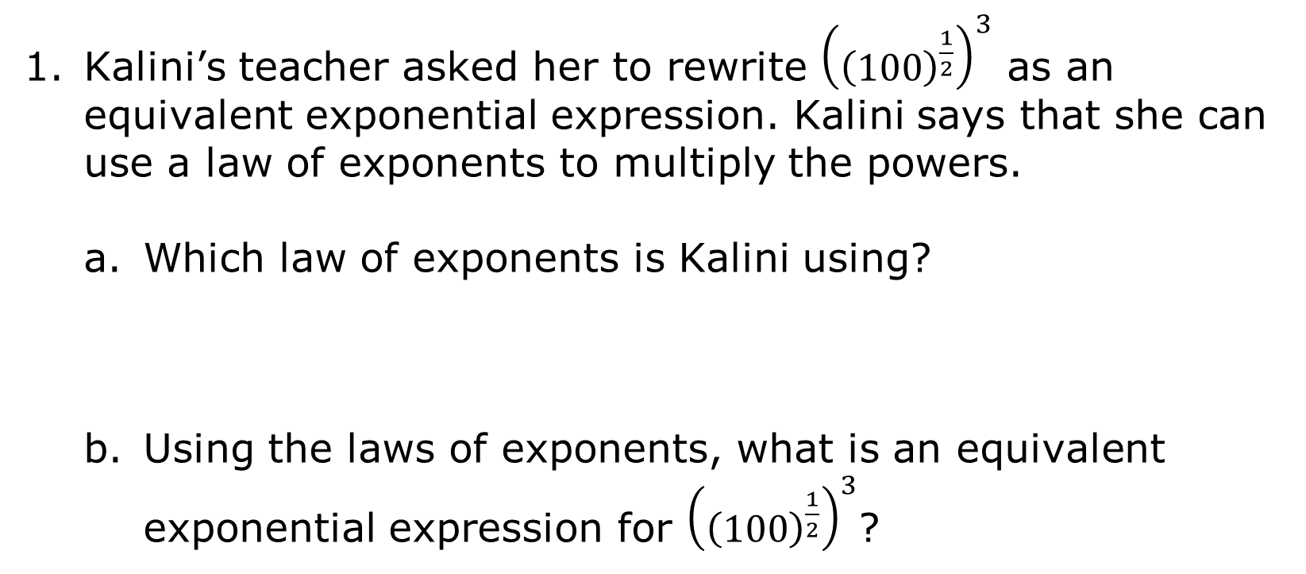
1.5.5 Guided Instruction: Exponent Laws with Rational Exponents
Kalini’s teacher asked her to rewrite ${\left({\left(100\right)}^{\frac{1}{2}}\right)}^{3}$ as an equivalent exponential expression. Kalini says that she can use a law of exponents to multiply the powers.
Which law of exponents is Kalini using?
Using the laws of exponents, what is an equivalent exponential expression for ${\left({\left(100\right)}^{\frac{1}{2}}\right)}^{3}$?
volume 1, pg. 30

Slide 21
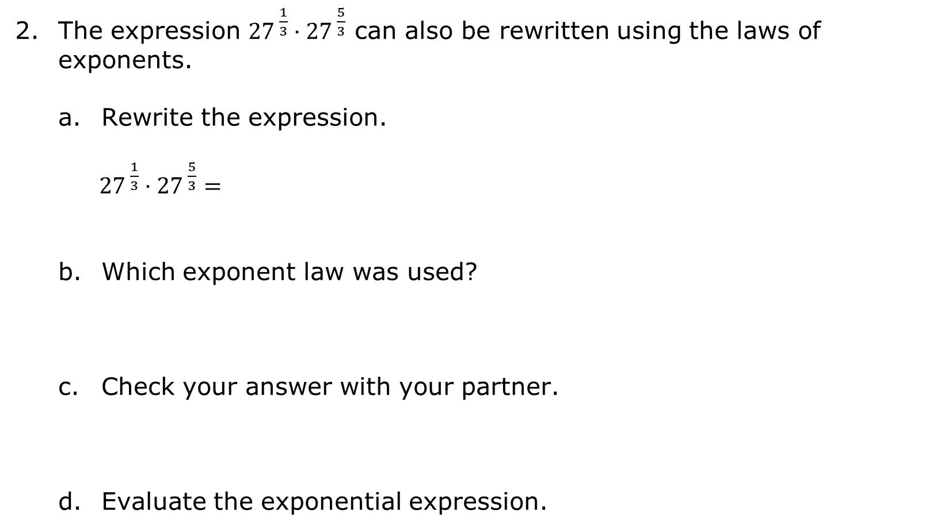
The expression ${27}^{ \frac{1}{3}}·{27}^{ \frac{5}{3}}$ can also be rewritten using the laws of exponents.
Rewrite the expression.
${27}^{ \frac{1}{3}}·{27}^{ \frac{5}{3}}=$
Which exponent law was used?
Check your answer with your partner.
Evaluate the exponential expression.
volume 1, pg. 30

Slide 22
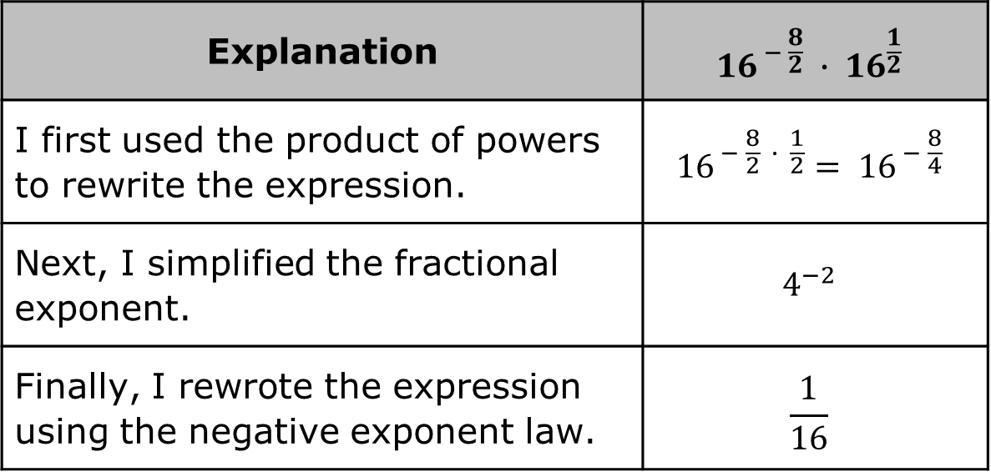
Maeko explained his work for rewriting the following expression.
Explanation | $${16}^{ − \frac{8}{2}} ∙ {16}^{\frac{1}{2}}$$
I first used the product of powers to rewrite the expression. | $${16}^{ − \frac{8}{2} ∙ \frac{1}{2}}= {16}^{ − \frac{8}{4}}$$
Next, I simplified the fractional exponent. | $$4^{−2}$$
Finally, I rewrote the expression using the negative exponent law. | $$\frac{1}{16}$$
Check Maeko’s work and explain any errors he may have made.
volume 1, pg. 31

Slide 23

Try It
volume 1, pg. 31

Slide 24
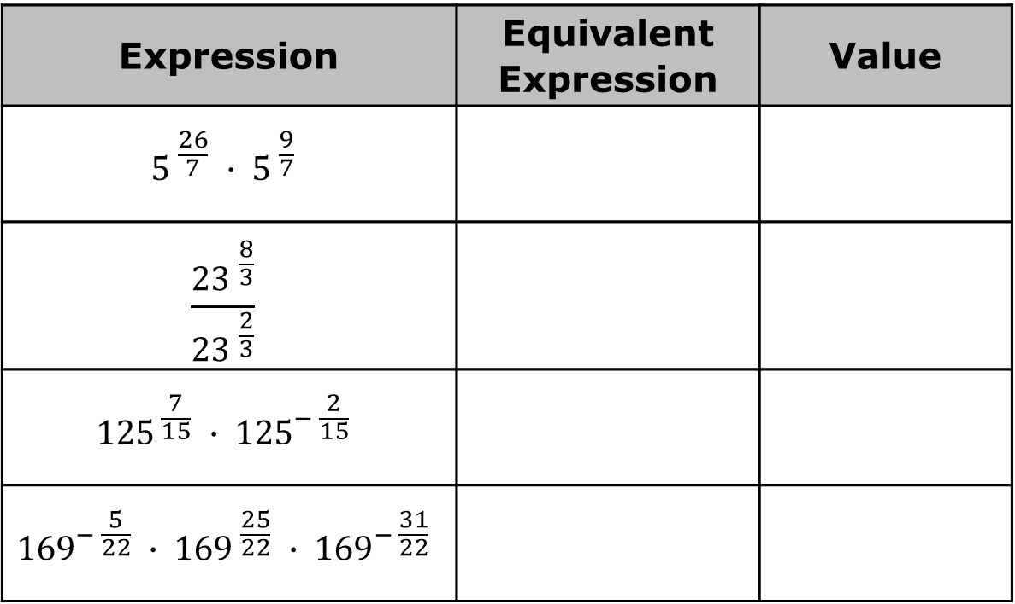
1.5.6 Try It: Writing Rational Exponents
Rewrite each expression using the laws of exponents. Then, evaluate the expression.
Expression | Equivalent Expression | Value
$${5 }^{\frac{26}{7}} ∙ {5 }^{\frac{9}{7}}$$
$$\frac{{23 }^{\frac{8}{3}}}{{23 }^{\frac{2}{3}}}$$
$${125}^{ \frac{7}{15}} ∙ {125}^{− \frac{2}{15}}$$
$${169}^{− \frac{5}{22}} ∙ {169 }^{\frac{25}{22}} ∙ {169}^{− \frac{31}{22}}$$
volume 1, pg. 31

Slide 25

Wrap-Up
volume 1, pg. 32

Slide 26

1.5.7 Wrap-Up: Ticket Out the Door
Find the value of the variable.
$\sqrt{14}={14}^{ \frac{1}{k}}$
$$k=______$$
${50}^{ \frac{1}{3}}=\sqrt[n]{50}$
$$n=______$$
volume 1, pg. 32

Slide 27
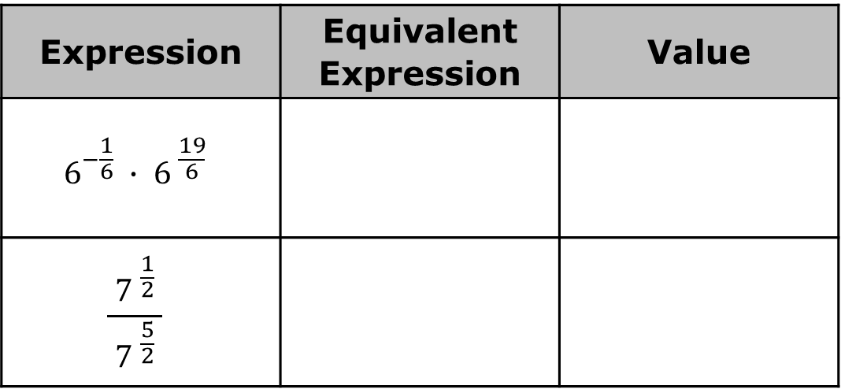
Complete the table by writing an equivalent expression using the laws of exponents. Then, evaluate the expression.
Expression | Equivalent Expression | Value
$$6^{−\frac{1}{6}} ∙ {6 }^{\frac{19}{6}}$$
$$\frac{{ 7 }^{\frac{1}{2}} }{{7 }^{\frac{5}{2}}}$$
volume 1, pg. 32

